Slide 1
CS 349
Final Project
CDs & Vinyls Dataset: Individual Task
Ian Shi

Slide 2
Individual Assignment Goals
Improve Group Task Results
Apply Neural Networks to Task
In the individual portion of the assignment, I look to continue to add to the work done in the group portion and improve the model predictions.
Another goal I aim to accomplish is to apply and use the NN tools learned in class to this project. I hope this will not only enhance my model, but also my understanding of deep learning

Slide 3
01
Continue to implement and refine existing and new features
Individual Assignment Steps
02
Use TF-IDF as another form of sentiment analysis
03
Use sklearn Pipeline to perform different tasks with multiple parameters
04
Implement NN with sklearn MLPClassifier

Slide 4
Feature Engineering
In group tasks 1 and 2, I implemented 17 product-focused features that spanned unique reviews, nltk VADER sentiment analysis, normalized time between reviews, max review upvote, and percentage of reviews from verified users. Below are new features added for the individual assignment.
Furthermore, all features were scaled to values between 0 and 1--something we did not do as a group
1
Length of Summary
3
# of Verified Reviews
Average number of words contained in each summary per product
Total raw number of verified reviewers per product
2
TF-IDF
4
Most Recent Review
Using sklearn’s tfidf vectorizer for another form of sentiment
Time (normalized) from most recent review

Slide 5
New Algorithms & Methods
1
New Feature Generation
RF, Decision Tree, LF algorithms using new features
2
TF-IDF
TF-IDF using sklearn
3
Pipeline & ColumnTransformer
Pipeline & ColumnTransformer to apply TF-IDF
4
MLPClassifier & Keras
Neural Network with sklearn MLPClassifier & Keras

Slide 6
Hyperparameter Optimization
Recursive Feature Elimination
Grid Search
Randomized Search
Sklearn’s RFECV function was used to to recursively test which features chosen during our feature engineering step should be prioritized in our model
Each feature is tested on a 10-fold cross-validation
Feature rankings are recorded, giving us a list of features for each model that should be used
Created RFE functions for classifiers w/o RFECV support
Sklearn’s GridSearchCV function was used to iteratively test different hyperparameters for each relevant model
Each hyperparameter pair was tested on a 10-fold cross-validation, with their mean F1 score recorded
Collected data was exported to a .csv file where we could analyze which set of hyperparameters gave us the best results
Sklearn’s RandomizedSearchCV function was used as another optimization method
Compared to Grid Search (which tests every combination), Randomized Search randomly selects combinations from a given subset. This is beneficial when testing on larger datasets like ours
Each hyperparameter pair was tested on a 10-fold cross-validation, with their mean F1 score recorded

Slide 7
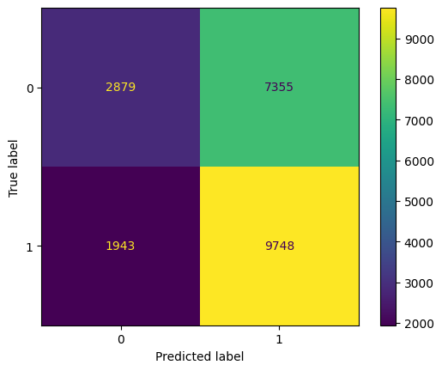
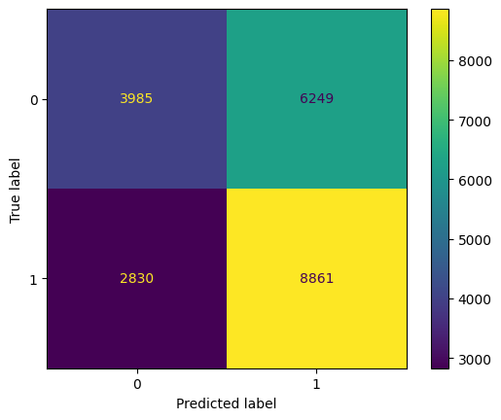
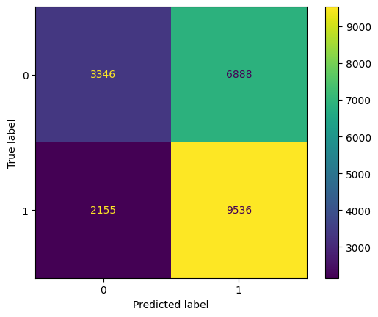
1. New Feature Generation
Previous classification methods such as RF, Decision Tree, and Late Fusion were performed on the dataset with the addition of the new features
Random Forest
Decision Tree
Late Fusion
max_depth: 1 | n_estimators: 49
max_depth : 4
Random Forest, Decision Tree, Logistic Regression
Features : all
Features : ['reviewerID', 'verified', 'rev_negSentiment', 'summ_negSentiment', 'rev_posNegRatio',
'normalized_time', 'norm_time_diff']
Precision: 0.57 | Recall: 0.83 | F1 Score: 0.68
Precision: 0.59 | Recall: 0.76 | F1 Score: 0.66
Precision: 0.58 | Recall: 0.83 | F1 Score: 0.685

Slide 8
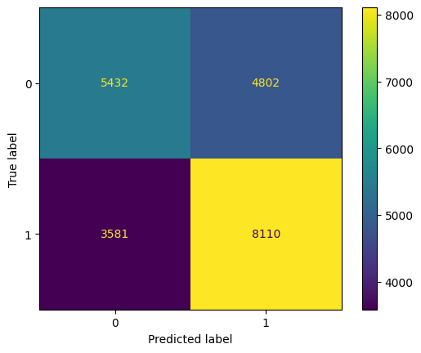
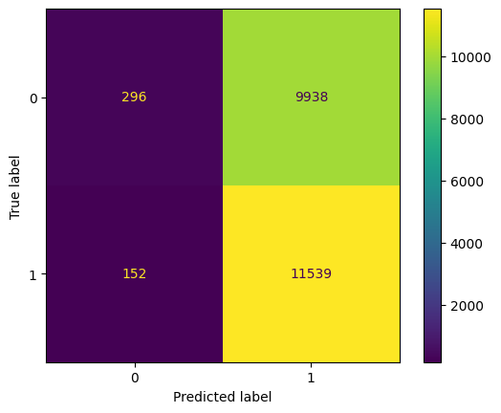
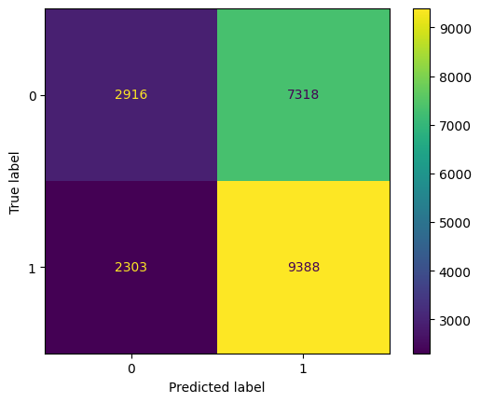
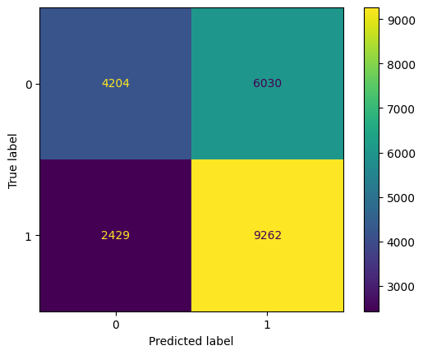
2. TF-IDF
Scikit Learn TFIDF was introduced and used to evaluate review sentiment
TFIDF Logit
TFIDF RF
TFIDF Tree
Precision: 0.63 | Recall: 0.69 | F1 Score: 0.66
Precision: 0.54 | Recall: 0.99 | F1 Score: 0.70
Precision: 0.56 | Recall: 0.80 | F1 Score: 0.66
TFIDF Late Fusion*
Precision: 0.61 | Recall: 0.79 | F1 Score: 0.70
*Model used

Slide 9
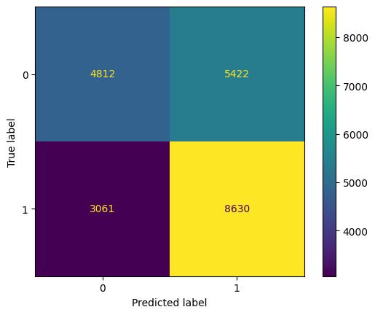
3. Pipeline & ColumnTransformer
Sklearn’s pipeline and column transformer feature was used to test TF-IDF along with the other features
Pipeline + RF
Precision: 0.61 | Recall: 0.74 | F1 Score: 0.67

Slide 10
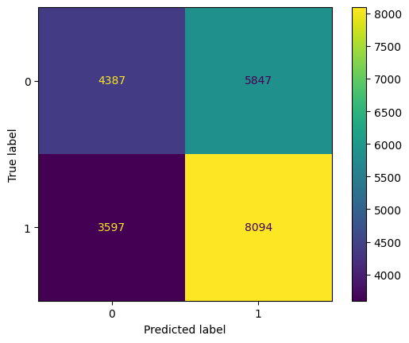
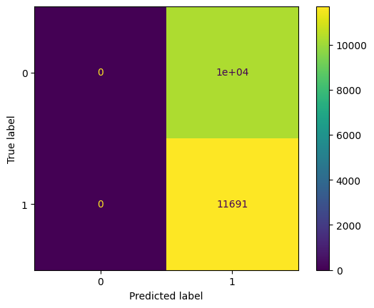
4. MLPClassifer & Keras
Using sklean MLPClassifer and Keras to implement neural networks
MLPClassifier
Keras
Activation: ‘relu’ | alpha: 0.001 | layer_sizes: (1024, 512, 256, 128)
Activation: ‘sigmoid’ | SGD | Dense: (16, 8, 4, 2)
Precision: 0.58 | Recall: 0.69 | F1 Score: 0.63
Precision: 0.53 | Recall: 1.00 | F1 Score: 0.69
*Using Keras with F1 score as primary metric leads to prediction of all 1’s after all epochs

Slide 11
Learnings
Feature Engineering
Hyperparameter Optimization
Machine Learning
Feature engineering is one of the most critical aspects of building a solid classifier
The success of our sklearn implemented classification or NN networks ultimately depends on the values of our features. Thus, in order to increase and improve the model, one of the first things to do is refine and adjust our features
Feature scaling is also important to ensure the scale of each feature is along the same axis, and no single feature dominates
For classification methods such as RandomForest and DecisionTree, hyperparameter optimization can be done rather simply using Grid Search or Randomized Search with the tradeoff being time and complexity
However, optimization with MLP becomes more difficult, especially in regards to the number of hidden layers
Researching online, there’s relatively little “general” layer rules that apply to any dataset
However, from testing, it seems multiple smaller layers works better than a smaller number of large layers
Machine learning is hard. There’s a lot of different aspects that can go wrong, and little things that can have big outcomes on the result
It’s important to check the confusion matrices and evaluate model metrics in a variety of ways. For example, on the training set, predicting all 1’s will give an F1 score of 0.69, but this doesn’t translate well to other datasets.

Slide 12
Next Steps
Neural Networks & Deep Learning
Continue to explore Keras and neural networks. Optimizing layer depth and is difficult and cumbersome, but also important in tuning the best classifier
With more time, try out different options keras and tensorflow have, explore more techniques and metrics to measure model performance.
Sentiment Analysis
Feature Engineering
Sentiment analysis was one of the biggest “black-box” unknowns during the preprocessing stage
Trying different models such as spaCY instead of nltk could product different or more accurate results
The features I chose gave mean results that made it hard to distinguish between “awesome” and “not awesome” products.
From the Keras performance, it seemed like the nominal features I choose (excluding TF-IDF), gave its highest F1 scores when we predicted all 1’s.
Sign that more distinguishing features are needed

